Slide 1
Strategies and Policies
Session 9

Slide 2
Strategy Definition
The determination of the mission or purpose and the basic long-term objectives of an enterprise, followed by the adoption of courses of action and allocation of resources necessary to achieve these aims.
A strategy is all about integrating organizational activities and utilizing and allocating the scarce resources within the organizational environment so as to meet the objectives.

Slide 3
Features of Strategy
Strategy is Significant because it is not possible to foresee the future. Without a perfect foresight, the firms must be ready to deal with the uncertain events which constitute the business environment.
Strategy deals with long term developments rather than routine operations, i.e. it deals with probability of innovations or new products, new methods of productions, or new markets to be developed in future.
Strategy is created to take into account the probable behavior of customers and competitors. Strategies dealing with employees will predict the employee behavior.

Slide 4
Policy Definition
General statements or understandings that guide manager’s thinking in decision making.
A set of ideas or a plan of what to do in particular situations that has been agreed to officially by a group of people, a business organization, a government, or a political party:

Slide 5
Strategic planning process
Clarify your vision
Gather and analyze information
Formulate a strategy
Implement your strategy
Evaluate and control

Slide 6
TOWS Matrix
The TOWS Matrix is derived from the SWOT Analysis model, which stands for the internal Strengths and Weaknesses of an organisation and the external Opportunities and Threats that the business is confronted with.
Whereas SWOT Analysis starts with an internal analysis, the TOWS Matrix starts the other way around, with an external environment analysis; the threats and opportunities are examined first.

Slide 7
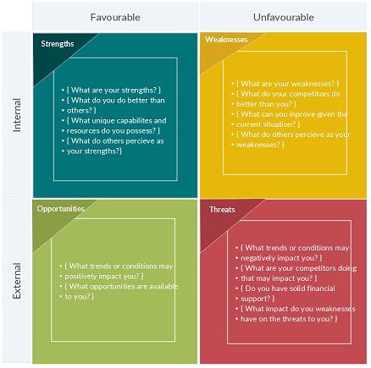

Slide 8
From that standpoint, an organisation gets a clear picture of its environment and the opportunity to think about strategy and what direction the company will go in. Next the company’s strengths and weaknesses are considered; what it’s good at internally and what it’s not so good at.
The external analysis is linked to the analysis and the resulting TOWS Matrix can help an organisation to make decisions better, seize opportunities and protect itself better against threats.

Slide 9
The TOWS Matrix is not just meant for the highest levels of management in an organisation. It can be a very useful tool for departments (i.e. a marketing or sales team) or for individual employees on an operational level. Once it’s employee’s or a department’s strengths are known, these can be improved further to become even better. The TOWS Matrix emphasizes the external environment.

Slide 10
Four Alternative strategies
This helps you identify strategic alternatives that address the following additional questions:
Strengths and Opportunities (SO) – How can you use your strengths to take advantage of the opportunities?
Strengths and Threats (ST) – How can you take advantage of your strengths to avoid real and potential threats?
Weaknesses and Opportunities (WO) – How can you use your opportunities to overcome the weaknesses you are experiencing?
Weaknesses and Threats (WT) – How can you minimize your weaknesses and avoid threats?

Slide 11
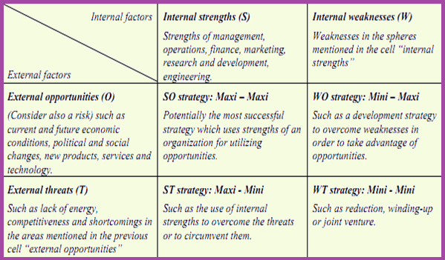
TOWS Matrix for strategy formulation

Slide 12
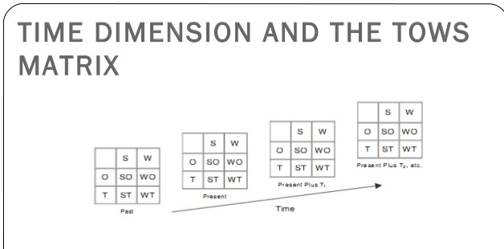
Time dimension and the TOWS Matrix

Slide 13
Application of the TOWS Merger Matrix for Mergers, Acquisitions, Joint ventures, and Alliances

Slide 14
SWOT ANALYSIS OD MC’DONALDS
Strengths in the SWOT analysis of McDonalds
Brand Equity…world-wide
42% of US fast-food hamburger business
Consistency of food
Successful items: Fries, Happy Meal, Big Mac, Egg McMuffin, Promotions
Overseas market
Balance sheet position

Slide 15
WEAKNESSES in the SWOT analysis of McDonalds
Declining market share
Weak product development
Disgruntled franchisees
Quality and taste of products
Slowed revenue and income growth

Slide 16
OPPORTUNITIES in the SWOT analysis of McDonalds
International expansion
Growing dining-out market
Joint ventures with retailers (e.g. supermarkets).
Consolidation of retailers likely, so better locations for franchisees.
Respond to social changes – by innovation within healthier lifestyle foods. Its move into hot baguettes and healthier snacks (fruit) has supported its new positioning.
Use of CRM, database marketing to more accurately market to its consumer target groups. It could identify likely customers (based on modelling and profiles of shoppers) and prevent brand switching[4].
Strengthen its value proposition and offering, to encourage customers who visit coffee shops into McDonalds.
The new “formats”, McCafe, having Wifi internet links should help in attracting segments. Also installing children’s play-parks and its focus on educating consumers about health, fitness.
Continued focus on corporate social responsibility, reducing the impact on the environment and community linkages.
International expansion into emerging markets of China and India.

Slide 17
THREATS in the SWOT analysis of McDonalds
Strength of competition
More health-conscious consumers
Changing demographics
Fluctuation of foreign exchange rates; Economies

